Slide 1
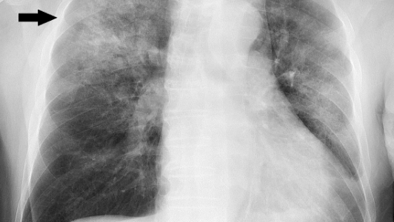
Pneumonia Detection From X-Ray Image
Group - 15
Faaizah Qadri
Yuvraj Singh
Pradumn Pandey
Arpan Pareek
Hemank Kumar
500109400
500109504
500109343
500109469
500107847
Using CNN

Slide 2
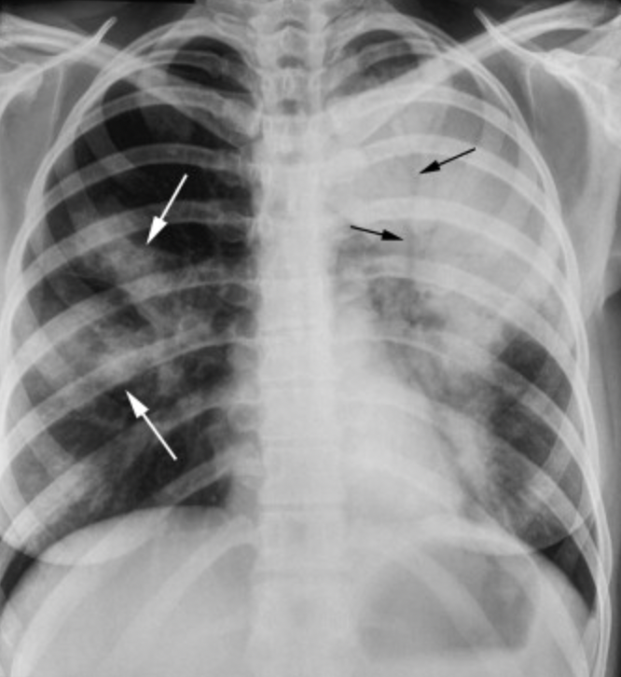
Problem Statement
Pneumonia is a leading cause of child mortality under five years old ∥ early, accurate detection significantly impacts outcomes
The project addresses the challenge of accurately classifying chest X-ray images to detect diseases.
Early and accurate detection through AI can improve diagnosis speed and patient outcomes.
Objective:
Develop and validate a deep learning model to classify chest X-ray images effectively

Slide 3
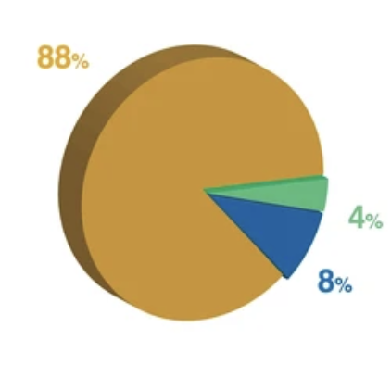
Dataset overview
Total Images: 13,977 images - Pneumonia vs Normal.
Dataset Split:
Training Set: 12,230 images (88%)
Validation Set: 1,165 images (8%)
Test Set: 582 images (4%)
Preprocessing:
Auto-Orientation applied to all images.
Resized images to 224x224 pixels.
Augmentation techniques:
Shear: ±3° horizontal, ±2° vertical
Saturation - -5% to +5%
Brightness & Exposure - -5% to +5%
The augmentation increases dataset diversity to help prevent overfitting.

Slide 4
Methodology
Data Collection
Source: Publicly available Chest X-Rays dataset from Roboflow.
Classes: Two categories - Normal and Pneumonia.
This dataset is curated from multiple verified medical image repositories, ensuring quality and diversity in patient demographics.
Data Preprocessing
All images were auto-oriented to correct rotation or flipping errors.
Resized uniformly to 224 × 224 pixels to match the model’s input requirements.
Removal of corrupted or low-quality images to maintain dataset integrity.

Slide 5
Methodology
Data Augmentation
Applied random shear transformations to simulate different angles of X-rays.
Adjusted saturation to account for variations in image acquisition equipment.
Applied brightness variations to mimic real-world lighting inconsistencies in scans.
Exposure adjustments to enhance contrast and feature visibility.
Augmentation improves generalization, helping the model perform better on unseen images.
Model Development
Developed a Convolutional Neural Network specifically designed for image classification tasks.
CNN layers automatically extract relevant spatial features - edges, textures, patterns from X-rays.
Model consists of convolutional layers for feature extraction.

Slide 6
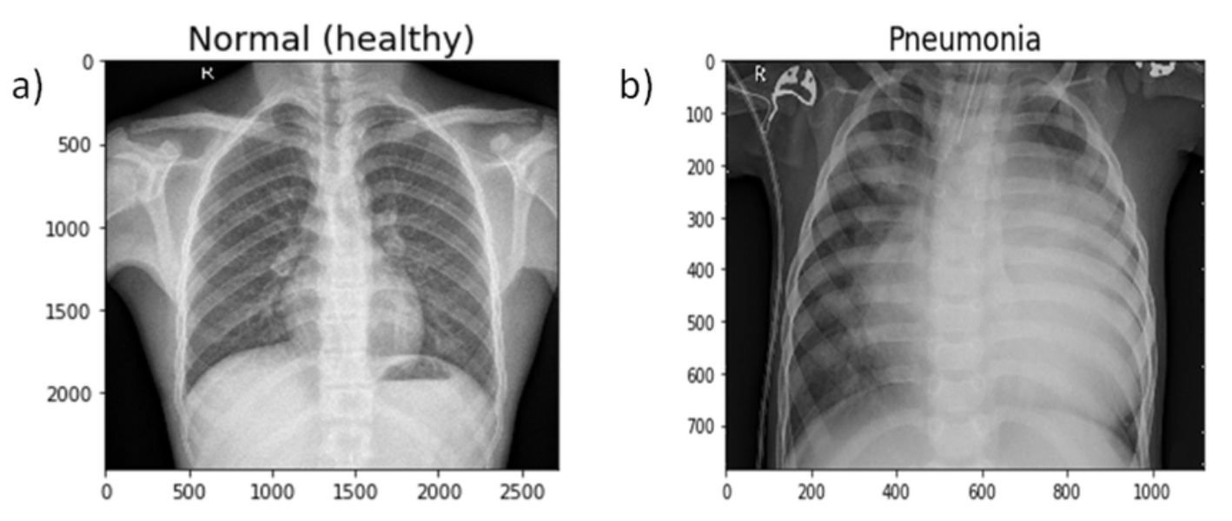
Methodology
Training and Validation
Train/Validation/Test Split:
88% - Training set
8% - Validation set
4% - Test set
Dropout layers used for regularization.

Slide 7
2 - Phase Training
Phase 1: Transfer Learning
Using a pre-trained CNN model as feature extractor.
Frozen convolutional layers to retain learned image features.
Phase 2: Fine-Tuning
Unfrozen top convolutional layers of the pre-trained model.
Trained entire network with a lower learning rate.
Allowed deeper layers to adapt specifically to chest X-ray patterns.

Slide 8
Challenges
Model Training:
Achieving higher accuracy required extensive fine-tuning of parameters.
Frontend Deployment:
Encountered errors due to deprecated packages and compatibility issues.
Backend Deployment:
Faced integration and environment configuration challenges during deployment.
Model Selection:
Had to evaluate multiple CNN architectures and justify the choice of MobileNetV2 over other models.

Slide 9
Limitations and Future work
Limitations:
Single disease focus: binary classification only.
Image stretching might distort anatomical features.
Future Work:
Expand the dataset with more diverse and multi-source images.
Explore advanced architectures like transfer learning with pre-trained models.
Handle Edge Cases

